Slide 1
FINAL PROJECT Image recognition- Flowers dataset
Brock Kanjicai
Shanker Nair
Ahmed Lotfy

Slide 2
OUTLINE
Image Classification Dataset
App demo
Machine learning models applied
Bringing it all together
Learnings and conclusions

Slide 3
Data set- Description
5 classes of flowers
Daisy
Dandelions
Roses
Sunflowers
Tulips
800 images in each class.
~ 4000 images in the dataset
102 classes of flowers
40 to 250 images in each class (8000 images)
Unable to find dataset split into classes

Slide 4
Machine Learning Models
Sequential Model
Transfer Learning
Model 1: Untrained
- 2 Dense layers
Relu activation function
----------------
Normalization
Model 2: Untrained
3 Convolution blocks
Relu activation function
Adam optimizer
Model 3: Trained
Pretrained on the ImageNet DB
Fine tune the model
Data Split:
Train data: 80%
Validation data: 10%
Test data: 10%
Performance optimization:
Cache
prefetch
Parametric hyper tuning:
Epochs
Batch size

Slide 5
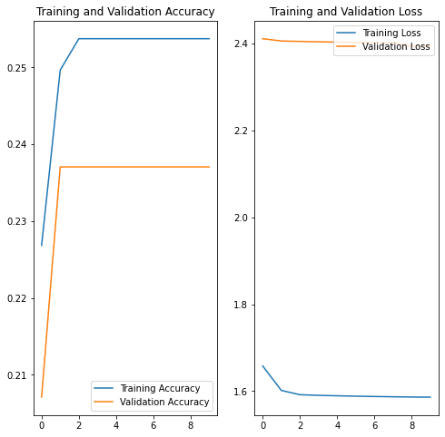
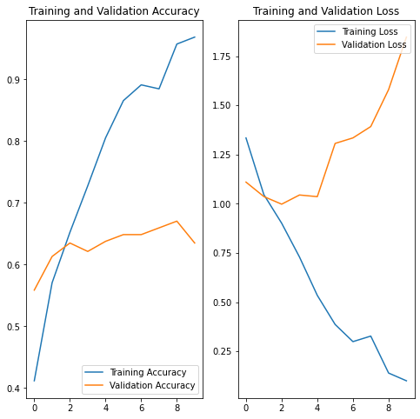
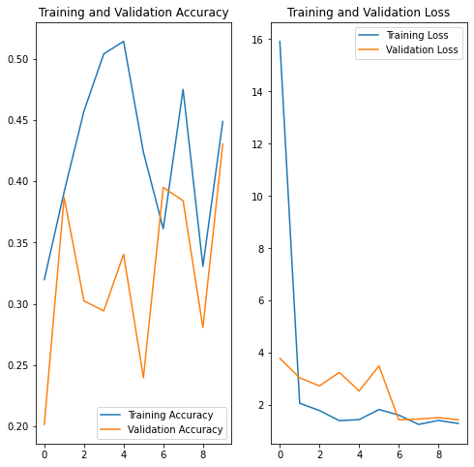
Machine Learning Models
Model 1: Untrained
Model 2: Untrained (Minor Hypertuning)

Slide 6
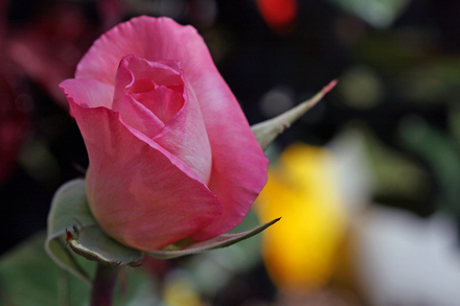
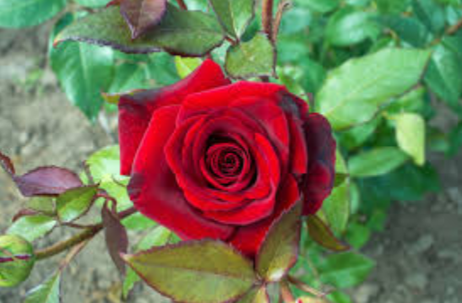

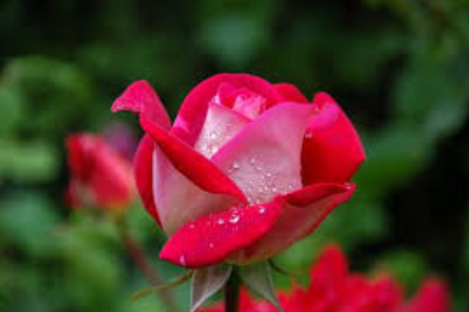
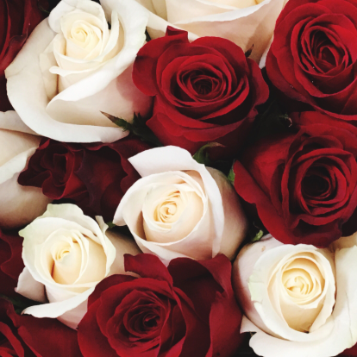
ROSES
Random image from the dataset
Images from the internet

Slide 7
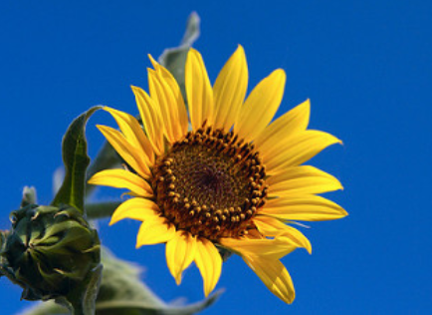
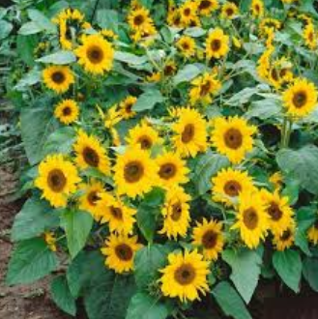
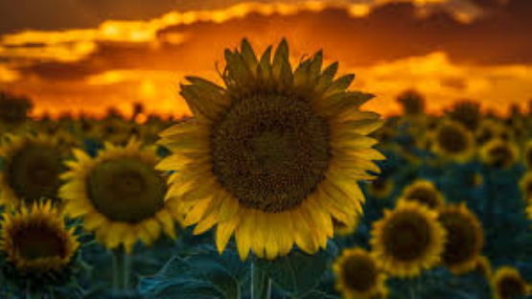
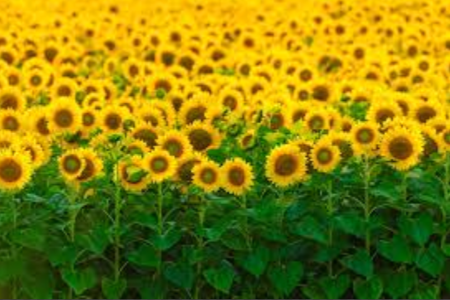
SUNFLOWER
Random image from the dataset
Images from the internet

Slide 8
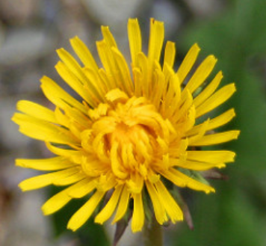
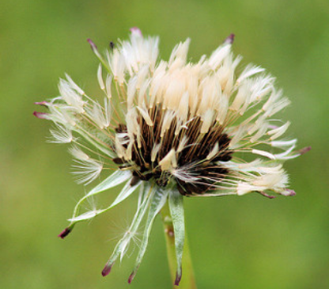
DANDELION
✗
✓

Slide 9
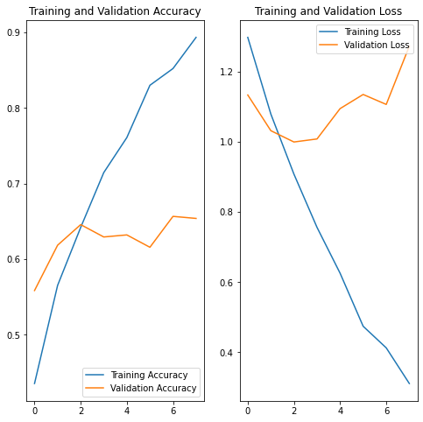
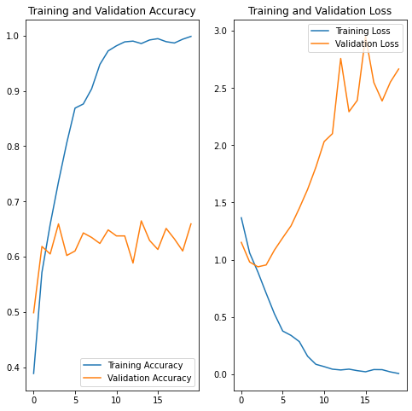
Hyper tuning Parameter: Epoch
Epochs = 8
Epochs = 10
Epochs = 16

Slide 10
Hyper tuning Parameter: Batch Size
Learning Rate
Batch Size
Momentum
Weight Decay
https://medium.com/@aiii/how-to-tune-hyper-parameters-in-deep-learning-a0fa4bc1d782
https://towardsdatascience.com/guide-to-choosing-hyperparameters-for-your-neural-networks-38244e87dafe

Slide 11
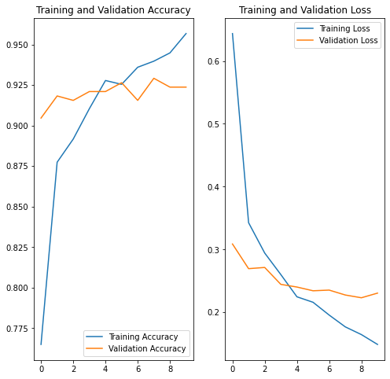
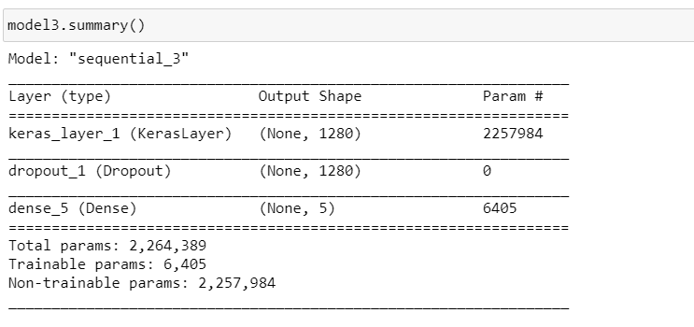
Machine Learning Models- Model 3
Model 3: Trained (Fine tuning)

Slide 12
SUMMARY
Challenges: Running the server file (original versus new)
Error in predicting certain flower classes was mitigated with the final trained model which was further fine-tunedwith the users dataset.
Option #2, although with a validation accuracy of only 65% is predicting random internet images as testing with the main model
Improvements that can be made:
Drop feature is available instead of browse and will be a good feature to try
Run more images on model #2 and try if it will break and further improve model #2 with hyperas and also manual tuning to understand the cause and effect.
A good understanding of the basics of ML will help tap into several online sources to the use case
Test accuracy
Model 1 | Model 2 | Model 3
45% | 65% | 93%

